Slide 1
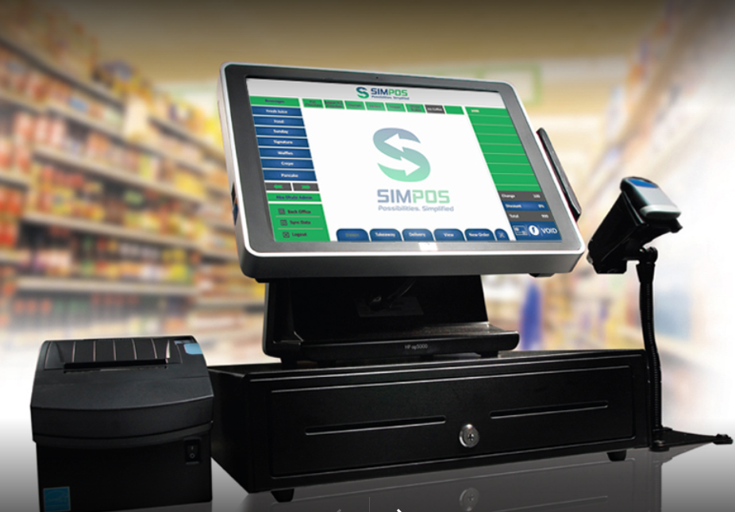

Supermarket Billing System

Slide 2
Supermarket Billing System
Prepared by:
Sujan Thapa (324423)
Raman Chaudhary (324416)
Anish Chaudhary (324408)

Slide 3
Introduction
Supermarket is the place where customers come to purchase their daily using products and pay for that.
In this system customer can choose & buy products and pay for that in different ways such as by (online or cash payment).
Customer can get bill after the payment is successful.
Entire Project is built by using C++ programming language.

Slide 4
Problem Statement
Stock list in the billing system is not shown which can be time consuming to find product details.
Customer satisfaction is the foremost important part in the business.
Bill must be generate automatically after payment is done by the customers.

Slide 5
Objective
The developed project will be user friendly.
‘Supermarket Billing will reduce paper work in the supermarket store.
“Billing System” is computerized system therefore it can handle large number of products.
Customer satisfaction can be made possible.

Slide 6
Aims
To reduce the traditional way of buying and selling product.
To reduce the time and cost.
To maintain the data of supermarket.
It helps to provide services to their customers in effective manner.

Slide 7
Scope
To design a effective & flexible system for both customers & businessman.
Provides quick process to buy & pay bill.
Reduce efforts in printing & managing bills.
Helps to maintain stocks in supermarket easily.

Slide 8
Applications
Scale Management
Fast End Accounting
Real time payment (online, cash)
Secure system

Slide 9
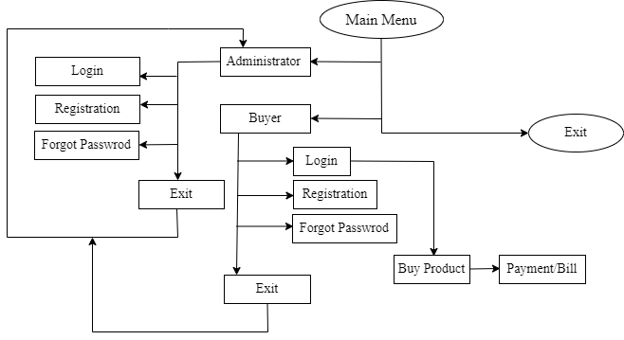
System Design
Fig: Block diagram of Supermarket Billing System

Slide 10
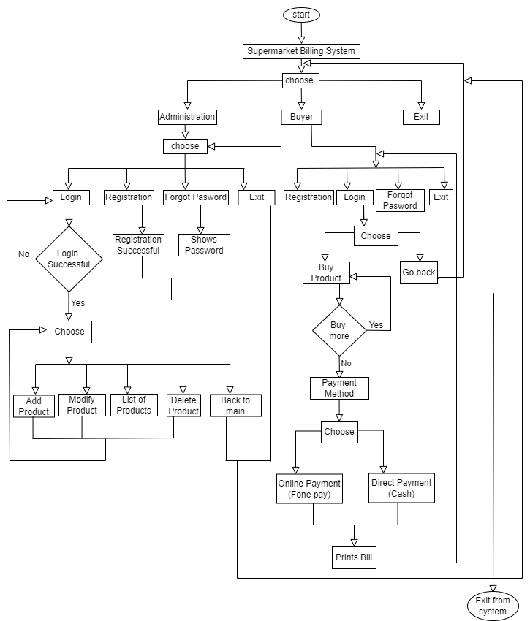
System Design
Fig: Flowchart of Supermarket Billing System

Slide 11
Implementation
In this part we have discussed about how we have use preprocessor directives in our project.
The implementation details within the multiple files is shown in detail.
Shows the use of .txt files in our project.

Slide 12
Expected Output
Shows the detailed information about stocks.
Gives security to the users
Prints bill automatically
Easy to use and handle

Slide 13
Conclusion
Beneficial for the use in supermarkets.
Faster in process & saves time.
Shows the list of goods with details.
This project can be expended further with many more new features in the future for better experience.

Slide 14
Demo…

Slide 15

Thank You

Slide 16
Any Questions…

